Slide 1
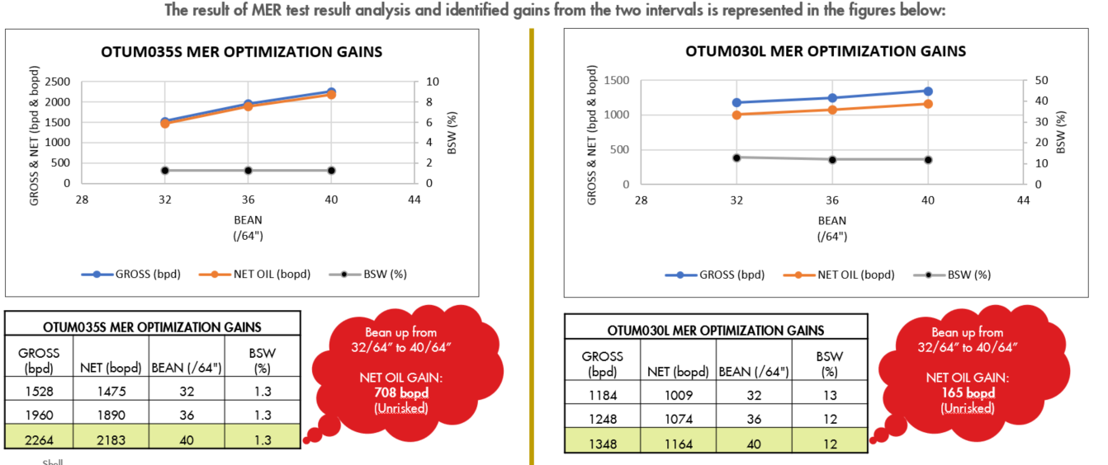
Title: 600bopd Gains to be actualized through identified Bean Optimization candidates: OTUM: 035S & 030L
Business Case/objectives:
Increase Otumara production by 600 (risked) through bean optimizations of OTUM035S and OTUM030L
The opportunities were identified through detailed surveillance and analysis carried out on the MER test results.
The FMT MER result analysis revealed that the step wise bean increments during the MER test has no effect on water cut as the produced water remained the same even after a two step bean up of the two intervals.
Potential Benefits & Measurement:
600bopd (Risked)
Critical Success Factors:
Availability of beans
Compressor Up time
High-level Timeline:
L0-L1: Apr 29 2019
Project Scope/Actions :
Design and issue MER test Plan
Receive MER test results
Carry out detailed review & analysis of the MER tests results
Carry out further analysis with the Otumara production creaming curve to evaluate new rates and AG rates against compressor capacity constriant
Share execution sequence with programmer and operations.
Implement bean up opportunities and test intervals
Report gains
Project Sponsor: Gogo Eneyok
Project members: Aliyu Olagunju
Erasmus Nnanna,
Somtochukwu Odumodu,
Stanley Otugeme

